Slide 1
Unit 5
Getting Started with Data

Slide 2
5Cs for Success
Coordinate
Comfort
Cooperate
Communicate & Connect
Continue
Notes:
The 5Cs here are based on a presentation done by Morénike Giwa Onaiwu, PhD- https://awnnetwork.org/directory/morenike-giwa-onaiwu/ for the Autism Community Training organization in March 2024.
Coordination
Questions and remarks are welcome
Gender neutral washrooms are located ___________
Sensory or quiet spaces are located ____________
Comfort- Do what you need to be comfortable!
Grab drinks or snacks and take breaks as you need them
Find a comfortable space (floor, various chairs and locations in the space, walking, standing)
Stimming devices and fidgets
Cooperate
Together for a period for a mutual goal, let’s be kind with one another
Be considerate of everyone’s backgrounds and perspectives,
Give people the benefit of the doubt, perceive that people are coming from a neutral place
Communicate and Connect
Share experiences with one another and connect with the material
Make it relevant to your life and interests
Continue
Learning is a process, review materials again later if something doesn’t stick
Ask your instructors to review or repeat

Slide 3
5Cs for Success
Coordination
Questions and remarks are welcome
Gender neutral washrooms are located ___________
Sensory or quiet spaces are located ____________
Comfort- Do what you need to be comfortable!
Grab drinks or snacks and take breaks as you need them
Find a comfortable space (floor, various chairs and locations in the space, walking, standing)
Stimming devices and fidgets
Cooperate
Together for a period for a mutual goal, let’s be kind with one another
Be considerate of everyone’s backgrounds and perspectives,
Give people the benefit of the doubt, perceive that people are coming from a neutral place
Communicate and Connect
Share experiences with one another and connect with the material
Make it relevant to your life and interests
Continue
Learning is a process, review materials again later if something doesn’t stick
Ask your instructors to review or repeat
Notes:
The 5Cs here are based on a presentation done by Morénike Giwa Onaiwu, PhD- https://awnnetwork.org/directory/morenike-giwa-onaiwu/ for the Autism Community Training organization in March 2024.

Slide 4

Your Technology Skills Progress
Windows 10
Microsoft 365
Google Workspace
Data Entry & Cleaning with Excel
Data Wrangling with Power Query
Data Modeling with Power BI
Data Visualization with Power BI
Data Querying with SQL
Notes:
Icon is Christania

Slide 5
Agenda
In this lecture, we are going to focus on…
Time | Topic
 | Movement Break
 | Movement Break

Slide 6
Learning Outcomes
By the end of the lecture, you will be able to…
Define data and the characteristics of quality data.
Explore a data set and identify characteristics, such as number of records/rows, number of features/columns, distribution of data by feature using filter and sort functions.
Define metadata and list some of the metadata characteristics of a data set.
Discuss the source of the dataset and its potential uses.
Differentiate between structured and unstructured data.
Identify the steps in a data pipeline.
Discuss the importance of capturing metadata and data versioning.

Slide 7
Today is an integrated lecture and lab day!
We will work through the lab exercises together
We will work at a balanced pace
If you are struggling to follow along, just watch for now and do the activities later.
Support each other in learning. Consider setting up study groups.

Slide 8
5.1
Definition of Data

Slide 9
What is Data?
Data can be anything that can be observed and recorded.
Everything around us can be data — from words in a sentence to items in your surroundings.

Slide 10
What is Data?
Raw facts, observations, measurements, records that can be input to ML models.
Learning models from data
Examples or cases from domain problems
Data may have many forms, such as:
An image, time series, text, video, and so on.
“
What we call data are observations of real-world phenomena. Each piece of data provides a small window into a limited aspect of reality.” — Page 1, Feature Engineering for Machine Learning, 2018.
Notes:
Modern AI models are using a huge amount of data to train a model to solve the problem.
Logic is our problem solving techniques. Symbols are how we are presenting problems to the computer.
A relations are adjectives or verbs which describe the symbol or how it interacts with other symbols.
How symbols place nicely together.

Slide 11
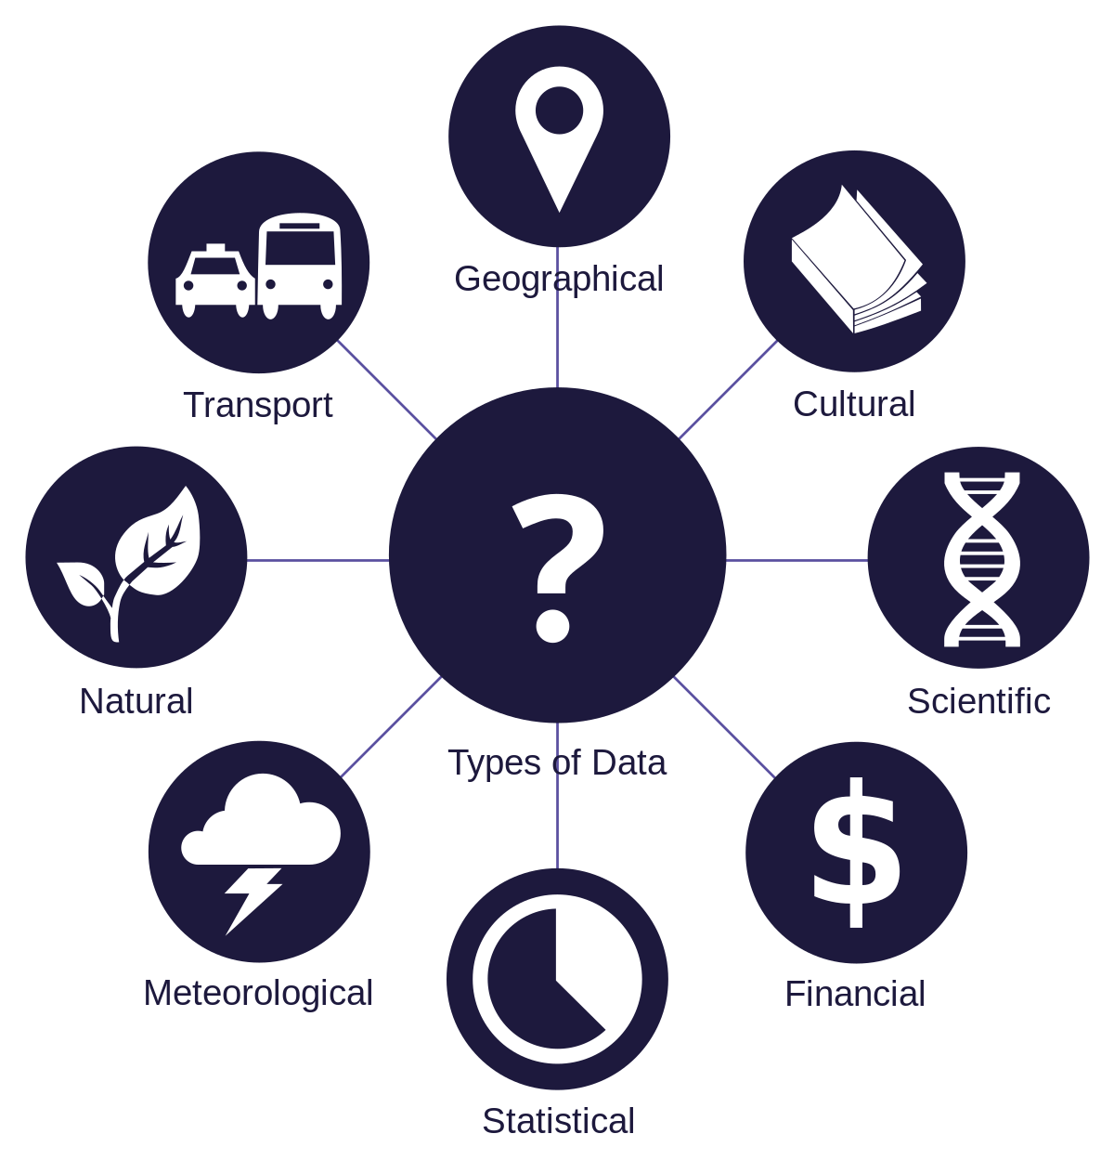
Data is More Than Just Numbers
Data includes numbers, words, genomic sequences, consumer products, and even literary works.
It represents discrete packets of evidence that can help us identify patterns and derive meaning.

Slide 12
Types of data
Qualitative or categorical data
Nominal data
Gender, Colors, eye color
Ordinal data
Education level, economic status
Quantitative data
Discrete data
Number of employees in company
Number of cars in parking lot
Continuous data
Height of a person, time, temparature
Notes:
<put your notes here>

Slide 13
Practical Example of Data
"The appointment with Dr. Watt is on Tuesday at 2:30pm at the Heslington Lane surgery.”
Fields of Data:
Person, Date, Time, Location
Task:
Organizing these into separate fields in a computer system like a spreadsheet.

Slide 14
5.2
Data sets

Slide 15
Datasets vs. Statistics
Datasets are collections of raw data stored in a digital format that is machine-readable. They can be analyzed using tools like Excel or SPSS. Datasets allow for extensive filtering, searching, and longitudinal analysis.
Statistics are processed data, refined from raw datasets through analysis. They often appear as tables, charts, or graphs and represent a fixed point in time.

Slide 16
Datasets vs. Statistics
Datasets are valuable for detailed analysis over time, helping to uncover trends and support reasoning or discussion. They are essential when you're asking "Why?" or "How?" about a particular phenomenon.
Statistics are useful when you need immediate figures to support a point, such as GDP, education enrollment rates, or crime statistics. They provide quick answers to "how many?" or "how much?" without the need for personal data analysis.

Slide 17
5.3
Metadata

Slide 18
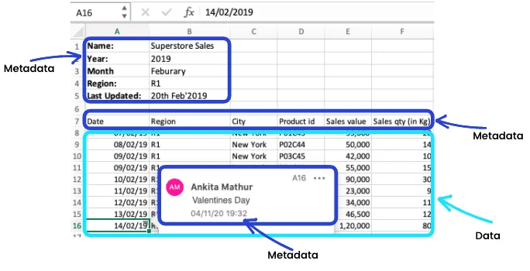
What is Metadata?
Metadata is often described as "data about data."
It provides information about other data, making it easier to find, use, and manage the original data effectively.

Slide 19
MetaData
Metadata refers to data that provides information about other data. It offers descriptive details that help users understand, interpret, and manage the content, context, and characteristics of a dataset, document, or resource. Metadata can include various attributes such as title, author, date created, format, and keywords, among others.
Example of Metadata:
Consider a photograph stored in a digital library. The metadata associated with this image could include: Title: "Golden Gate Bridge“ Author/Creator: John Smith Date Created: July 10, 2021 Location: San Francisco, California Description: A panoramic view of the Golden Gate Bridge on a sunny day. Keywords: Bridge, Landmark, Architecture, San Francisco, Bay Area File Format: JPEG File Size: 2.5 MB Resolution: 1920x1080 pixels Camera Model: Canon EOS Rebel T7i Exposure Settings: f/8, 1/1000 sec, ISO 200
Notes:
information that has been formatted and transformed into a well-defined data model. The raw data is mapped into the SQL relational database, consisting of tables with rows and columns, are the perfect example of structured data:
Minimize data redundancy
Utilize memory
More interdependent data
Less flexible
E.g. POS data like quantity, barcodes or spreadsheets
Present in absolute raw form
Difficult to process
Complex arrangement and formatting
E.g. Web pages, Paragraph from a book
a type of data that has some consistent and definite characteristics
An image itself doesn’t have a pre-defined structure but it has certain structural attributes making them semi-structured:
Date stamp,Geotag,

Slide 20
Why is Metadata Important?
Metadata helps organize data, making it searchable and sortable.
It's essential for data management, especially in large databases or digital archives.
automate processes
searchable and sortable
Management
In digital systems, metadata can automate processes like data retrieval and data archiving, enhance the compatibility between different systems, and improve data security by tracking access and changes.

Slide 21
Examples of Metadata
For a book, metadata includes the author, title, publisher, and ISBN.
For a digital photograph, metadata might include the date taken, camera settings, and location.

Slide 22
5.4
Data Sources and Uses

Slide 23
Types of Data Sources
Primary Sources
Directly obtained data
e.g.surveys, experiments
Secondary Sources
Data collected from existing resources
e.g., books, journals, databases
Tertiary Sources
Aggregations of primary and secondary sources
e.g., encyclopedias, directories

Slide 24
5.5
Data Types

Slide 25
Why Data Types Matter
Choosing the right data type is crucial for effective data analysis
It affects
data storage
processing speed
the accuracy of insights derived from the data

Slide 26
Data Structures
Structured Data
Highly organized data
databases or spreadsheets
Unstructured Data
Data without a predefined format or structure
e.g. social media posts

Slide 27
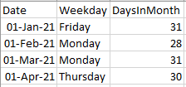
Structured Data
Data organized into rows and columns in the form of text or numbers

Slide 28
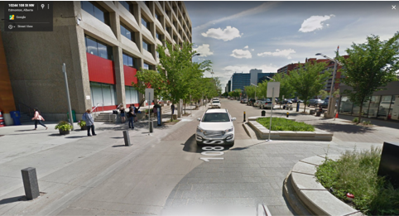





Unstructured Data
Data not entered and organized into the rows and columns of a spreadsheet, in the form of things like pictures, sound files or documents

Slide 29
Structured Data
Structured data is highly organized and formatted according to a predefined schema or model.
It typically resides in relational databases or spreadsheets where each data element has a specific format and meaning.
Examples:
SQL databases (e.g., MySQL, PostgreSQL)
Excel spreadsheets with well-defined columns and rows
CSV (Comma-separated values) files
XML (eXtensible Markup Language) documents with defined tags and attributes
JSON (JavaScript Object Notation) files with organized key-value pairs
Notes:
information that has been formatted and transformed into a well-defined data model. The raw data is mapped into the SQL relational database, consisting of tables with rows and columns, are the perfect example of structured data:
Minimize data redundancy
Utilize memory
More interdependent data
Less flexible
E.g. POS data like quantity, barcodes or spreadsheets
Present in absolute raw form
Difficult to process
Complex arrangement and formatting
E.g. Web pages, Paragraph from a book
a type of data that has some consistent and definite characteristics
An image itself doesn’t have a pre-defined structure but it has certain structural attributes making them semi-structured:
Date stamp,Geotag,

Slide 30
Unstructured Data
Unstructured data lacks a predefined schema or organization and does not fit neatly into traditional database structures.
It often contains text-heavy content and may include multimedia files such as images, videos, and audio recordings.
Examples:
Text documents (e.g., Word documents, PDFs)
Emails and social media posts
Images and videos
Audio recordings
Web pages and blog posts
Customer reviews and feedback
Notes:
information that has been formatted and transformed into a well-defined data model. The raw data is mapped into the SQL relational database, consisting of tables with rows and columns, are the perfect example of structured data:
Minimize data redundancy
Utilize memory
More interdependent data
Less flexible
E.g. POS data like quantity, barcodes or spreadsheets
Present in absolute raw form
Difficult to process
Complex arrangement and formatting
E.g. Web pages, Paragraph from a book
a type of data that has some consistent and definite characteristics
An image itself doesn’t have a pre-defined structure but it has certain structural attributes making them semi-structured:
Date stamp,Geotag,

Slide 31
5.6
Data Pipeline

Slide 32
What is a Data Pipeline?
A data pipeline is a set of processes that automate the flow of data from one point to another, facilitating the efficient and reliable analysis of large volumes of data.
data collection
processing
Analysis
Cleaning and Preparation
Storage
Monitoring and Management
Archiving and Retention

Slide 33
Step 1 - Data Collection
The first step in a data pipeline where data is gathered from various sources.
Includes databases, web services, local files, and other external sources.

Slide 34
Step 1 - Data Collection
Real-Life Examples:
Databases: A retail company collects sales data from its database to analyze sales trends and customer preferences.
Web Services: A weather forecasting app collects data from various web services to provide accurate weather predictions.
Local Files: A teacher collects student grades stored in local files (spreadsheets) to track academic progress.
External Sources: A health researcher collects data from public health records and surveys to study the spread of a disease.

Slide 35
Step 2 - Data Cleaning and Preparation
Data is cleaned and prepared to ensure quality and consistency.
This involves removing duplicates, correcting errors, and transforming data into a usable format.

Slide 36
Step 2 - Data Cleaning and Preparation
Real-Life Examples:
Removing Duplicates: In a customer database, duplicate entries for the same customer can lead to inaccurate analyses. For example, John Doe might be listed twice due to a typo in one of the entries.
Correcting Errors: Data entry errors, such as incorrect dates or misspelled names, need to be corrected to maintain data integrity. For instance, an entry might list "12/25/20224" instead of "12/25/2024."
Transforming Data: Converting all date formats to a standard format (e.g., MM/DD/YYYY) or ensuring consistent use of units (e.g., converting all measurements to metric units).

Slide 37
Step 3 - Data Processing
Processed data undergoes analysis or manipulation to extract insights or transform it into a more useful form.
This can involve sorting, summarizing, aggregating, or complex data transformations.

Slide 38
Step 3 - Data Processing
Real-Life Examples:
Sorting: Arranging sales data in descending order to identify the top-performing products.
Summarizing: Calculating the average customer satisfaction rating from survey responses.
Aggregating: Summing up monthly sales figures to obtain a quarterly sales total.
Complex Transformations: Using a pivot table to reorganize and summarize detailed transaction data.

Slide 39
Step 4 - Data Storage
Processed data is stored in a structured form in databases or data warehouses.
This storage serves as the foundation for querying and further analysis.

Slide 40
Step 4 - Data Storage
Real-Life Examples:
Databases: A library management system stores book details, member information, and loan records in a database to track and manage operations efficiently.
Data Warehouses: A retail company aggregates sales data from various stores into a data warehouse to perform high-level analysis and generate business insights.

Slide 41
Step 5 - Data Analysis
Stored data is analyzed to generate reports, dashboards, and visualizations.
It helps in making data-driven decisions and insights.

Slide 42
Step 5 - Data Analysis
Real-Life Examples:
Business: A company analyzes sales data to identify top-performing products and make inventory decisions.
Healthcare: A hospital analyzes patient data to improve treatment plans and patient outcomes.
Education: A school analyzes student performance data to tailor educational programs and interventions.

Slide 43
Step 6 - Data Monitoring and Management
Continuous monitoring is essential to ensure the data pipeline functions smoothly.
This involves managing data flow, detecting failures, and troubleshooting issues.

Slide 44
Step 6 - Data Monitoring and Management
Real-Life Examples:
Business: A retail company monitors its inventory data flow to ensure that stock levels are updated in real time. Any discrepancies or failures are quickly addressed to prevent stockouts or overstocking.
Healthcare: Hospitals monitor patient data systems to ensure continuous data flow for patient records. Immediate detection of any data entry failures or system issues is critical to maintaining patient care.
IT Infrastructure: IT departments monitor network data flow to detect and resolve any disruptions that could impact business operations.

Slide 45
Step 6 - Data Monitoring and Management
Data Monitoring and Management Techniques:
Automated Alerts and Notifications: Set up automated alerts to notify administrators of any data flow issues or failures.
Regular Data Audits: Perform regular audits to ensure data accuracy and integrity.
Data Quality Checks: Implement checks to validate data at various points in the pipeline.
Backup and Recovery Plans: Establish robust backup and recovery plans to prevent data loss and ensure quick recovery in case of failures.
Performance Monitoring: Continuously monitor system performance to identify and resolve bottlenecks.

Slide 46
Step 7 - Data Archiving and Retention
Final step involves archiving inactive data and managing the retention of data based on compliance and business needs.
Real-Life Examples:
Business: A company archives financial records at the end of each fiscal year to meet legal requirements and retrieve them for audits if necessary.
Healthcare: Hospitals archive patient records after a certain period while ensuring compliance with health regulations for data retention.
Education: Schools archive student records after graduation but retain them for several years in case they are needed for future reference or verification.

Slide 47
Step 7 - Data Archiving and Retention
Data Archiving and Retention Techniques:
Archiving Policies: Establish policies for what data should be archived and when.
Retention Schedules: Define how long different types of data should be retained based on legal and business requirements.
Secure Storage: Ensure archived data is stored securely, often in a different location or system from active data.
Data Retrieval: Implement processes for retrieving archived data when needed.
Data Deletion: Establish procedures for securely deleting data once the retention period has expired.

Slide 48
5.7
Versioning

Slide 49

What is Data Versioning?
Data versioning refers to the practice of keeping multiple versions of datasets or data elements to track changes over time.

Slide 50
Data Versioning
Crucial for data integrity and reproducibility in data analysis and software development.
It helps manage changes and prevent conflicts, especially in collaborative environments.
It enables tracing data history, facilitates error correction, and supports data analysis consistency.

Slide 51


Data Versioning Tool
Git is a distributed version control system used primarily for source code management but also effective for various types of data versioning.
Key features:
Branching
Allows users to work on independent branches without affecting the main project, making it easy to experiment and merge changes.
Commit History
Each change is recorded with a commit message, author, and timestamp, providing a complete history of modifications.
Remote Repositories
Enables collaboration by allowing multiple users to push to and pull from remote repositories, such as GitHub or Bitbucket.

Slide 52
Summary
Data can be anything that can be observed and recorded.
Metadata provides information about other data, making it easier to use it effectively.
Sources: Primary, Secondary, Tertiary
Data can be Structured or Unstructured
A data pipeline automates the flow of data making it more efficient for large volumes of data.
Versioning enables tracing data history, facilitates error correction, and supports data analysis consistency.

Slide 53
Learning Check In
How well do you know the learning content from today?
Rate yourself.
1
2
3
4
Not Yet
Review
Understand
Use
I don’t understand it all yet
And I may need some support to do it correctly
I understand most of it
But I need to do some review or practice on my own
I understand it
And I can do it
I understand it
I can do it
And I am also ready to try to use it in a new context

Slide 54
What is one thing you think you need to review from today’s learning?
OR
Something you want to find out more about?

